Slide 1


Blocking vs Non-Blocking in JavaScript
Understanding Asynchronous Behavior with Examples.
by muniba khan

Slide 2
JavaScript's Execution Context
Single-Threaded Nature
Asynchronous Capabilities
JavaScript operates on a single thread. It executes one task at a time.
JavaScript is non-blocking. It can handle multiple tasks asynchronously.
Understanding blocking versus non-blocking is key. It will allow you to write efficient code.

Slide 3

Blocking Code: The Halt
Definition
Freezing the Thread
Blocking code halts the execution of subsequent code. It waits until the current task is completed.
It freezes the main thread. This makes the page unresponsive during execution.
Example
console.log("Start");
for (let i = 0; i < 1e9; i++) {} // Heavy computation (Blocking)
console.log("End");

Slide 4




Non-Blocking Code: The Flow
Definition
Example
Benefit
Execution continues. It does not wait for a previous operation to finish.
The rest of the code executes without waiting. It creates a smoother user experience.
console.log("Start");
setTimeout(() => { console.log("Inside Timeout"); }, 2000);
console.log("End");

Slide 5

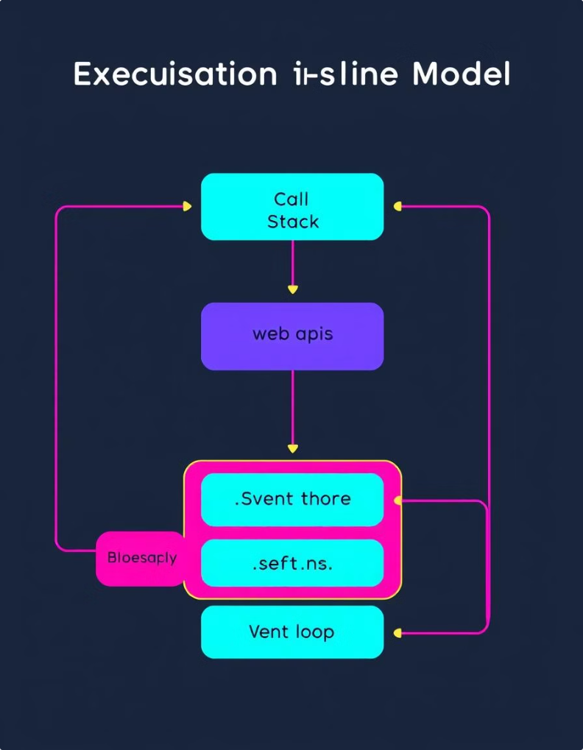
JavaScript Execution Model
1
Call Stack
Handles function execution. This is the heart of JavaScript's synchronous operations.
2
Web APIs
Handles asynchronous tasks. Examples: setTimeout, fetch, and event listeners.
3
Callback Queue
Stores async callbacks for execution. Callbacks wait their turn to be processed.
4
Event Loop
Moves tasks. It transfers them from the Callback Queue to the Call Stack when empty.

Slide 6





Asynchronous Methods in JavaScript
setTimeout & setInterval
Callbacks
Promises
Async/Await

Slide 7
Promises: A Non-Blocking Example
Fetch request runs. It operates in the background without blocking execution.
The request retrieves data asynchronously. This ensures the main thread remains responsive.
console.log("Start");
fetch("https://jsonplaceholder.typicode.com/posts/1")
.then(response => response.json())
.then(data => console.log("Data Fetched:", data));
console.log("End");

Slide 8

Async/Await: Modern Approach
1
Clean Syntax
2
Readability
3
Non-Blocking
Looks synchronous. But it runs asynchronously in the background.
Simplifies asynchronous code. This makes it easier to understand and maintain.
async function fetchData() {
console.log("Start");
let response = await fetch("https://jsonplaceholder.typicode.com/posts/1");
let data = await response.json();
console.log("Data Fetched:", data);
console.log("End");
}
fetchData();

